Slide 1
A Firefly Algorithm-based Approach for Pseudo-Relevance Feedback
GROUP MEMBERS
SHAMITHA S UDUPA 15IT141
SANJANA B 15IT239
03/05/2018
IR Project End Semester Evaluation

Slide 2
Agenda
Introduction
Literature Survey
Outcome of Literature Survey
Motivation
Problem Statement
Objectives
Proposed Model
Methodology
Work done
Results
Innovative Work Done
Future Work
Time-line of Project
References
03/05/2018
IR Project End Semester Evaluation

Slide 3
Introduction
Volume of information available on World Wide Web is increasing tremendously. As a result many new words (proper names, abbreviations, misspellings) are introduced. Using such words in queries increases the difficulty to extract their meaning resulting in the failure of Web search engines due to extraction of irrelevant documents.
Query Expansion is a promising method to overcome this problem wherein new keywords are augmented to the original query to produce a more useful query i.e. a query that is more likely to retrieve relevant information.
03/05/2018
IR Project End Semester Evaluation

Slide 4
Literature Review
Authors | Methodology | Advantages | Limitations
Claudio Carpineto and Giovanni Romano | A Survey of Automatic Query Expansion in Information Retrieval | Based on state of art functions Document scoring-okapi BM25 Pseudo-relevant documents scored with RSJ and Rocchio’s weight | Selects expansion keywords instead of best expanded query
Miao, J., Huang, J. X., and Ye, Z., | Proximity-based Rocchio’s Model for Pseudo Relevance Feedback | Considers the proximity relationship between expansion terms and query terms | It does not surpass state-of-art query retrieval techniques
03/05/2018
IR Project End Semester Evaluation

Slide 5
Literature Review
Authors | Methodology | Advantages | Limitations
Cao, G., J-Y. Nie, J. Gao, and S. Robertson | Selecting good expansion terms for pseudo-relevance feedback | Uses supervised learning method (CSVM ) to separate good expansion terms based on impact on the retrieval effectiveness | For new datasets finding good expansions terms will be expensive
Lee, K. S., and Croft, W. B., | A deterministic resampling method using overlapping document clusters for pseudo-relevance feedback | Overlapping clusters to find dominant documents and repeatedly use these documents to emphasize the core topics of a query | It may skip some documents in the initial high –rank documents and deterministically construct overlapping clusters
03/05/2018
IR Project End Semester Evaluation

Slide 6
Literature Review
Authors | Methodology | Advantages | Limitations
Bindal, A. K., and Sanyal, S. | Particle swarm optimization algorithm to improve pseudo relevance feedback | Simplicity of implementation, its convergence and effectiveness. | The achieved results are almost similar to those of the state-of-the-art
03/05/2018
IR Project End Semester Evaluation

Slide 7
Outcome of Literature Review
Currently most query expanding algorithms are concerned with finding the best expansion keywords. These methods give results similar to the state-of-art techniques.
It might be better to look at the query expansion problem from the perspective of expanded query. In this way the context of the query is also taken into consideration.
Swarm optimisation techniques similar to PSO can be considered to find the best expanded query from the population of expanded queries.
03/05/2018
IR Project End Semester Evaluation

Slide 8
Motivation
Using optimization algorithms to find best expanded query among a set of query candidates would be a best option compared to the previous approaches.
Firefly algorithm was selected which is more general compared to PSO.
Firefly algorithm includes features like random walk strategy, annealing strategy for premature convergence avoidance. It balances between effectiveness and efficiency.
03/05/2018
IR Project End Semester Evaluation

Slide 9
Problem Statement
To increase the retrieval effectiveness of pseudo-relevance feedback using firefly algorithm to find best expanded query while maintaining low computational cost.
03/05/2018
IR Project End Semester Evaluation

Slide 10
Research Objectives
To construct the inverted index of documents in MEDLINE database
To build Okapi BM25 model to rank the pseudo relevant documents
Implementation of firefly algorithm to find the best expanded query
Evaluate the performance : Precision and MAP
Comparison of results
03/05/2018
IR Project End Semester Evaluation

Slide 11
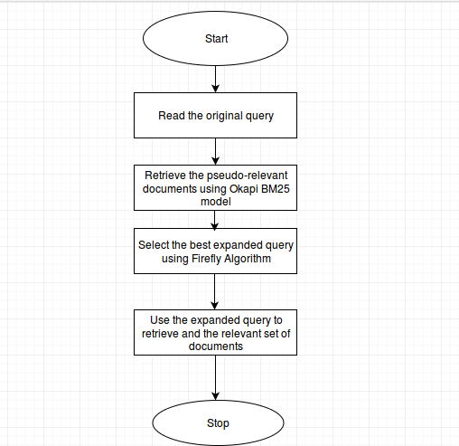
Proposed Model
03/05/2018
IR Project End Semester Evaluation

Slide 12
Proposed Model
Pseudo Code for the proposed firefly algorithm:
Define light absorption coefficient L, parameter a
Light intensity I_{i} at Q’_{I} is determined by fitness function of Q’_{I}
Generate initial population of n fireflies(Q’_{i})
while not stopping condition:
for i in range(1,n):
for j in range(1,n):
if f(Q’_{i}) < f(Q’_{j}) :
move Q’_{I} towards Q’_{j}
Change attractiveness
Evaluate new solution
Rank the fireflies and find the current best EQ
03/05/2018
IR Project End Semester Evaluation

Slide 13
Proposed Model
Fitness function Pseudo code:
Calculate inverted index for each term q_{i} in Expanded query(EQ).
Initialise vector S for scores
For each q_{i} in Q’ :
For each d_{j} in R:
if d_{j} belongs to IN(q_{i}) and S[d_{j}] != 0 :
S[d] = BM₂₅ (d_{j} , Q) + BM₂₅ (d_{j} , Q’)
Fitness score = Max(S)
03/05/2018
IR Project End Semester Evaluation

Slide 14
Methodology
At each iteration update firefly location:
xt+1 i = xt i +β(xt j −xt i)+α(rand− 1 /2) where
xt i : current position of the firefly
β = 1/(1 + γ r_{ij})
r_{ij} is distance between firefly i and firefly j (Distance metric : Hamming distance i.e the number of non-corresponding elements in the sequence)
Example
Q1 = {a1,a2,a3,a4,a5} Q2 = {a1,a3,a5,a6,a7} then hamming distance is 2 = |{a2,a4}| = |{a6,a7}|
The randomization parameter α is very important in a Firefly Algorithm as it avoids the solutions being trapped at local optima. Its value is gradually decreased to prevent the algorithm from the premature convergence
03/05/2018
IR Project End Semester Evaluation

Slide 15
Methodology
Second term calculation based on β to bring the Q_{i} closer to Q_{j} :
Q^{t+1}_{ik} = Q^{t}ik, if rand > β
= `Q^{t}jl , otherwise
Where Q^{t}ik belongs to Q^{t}_{i} and not Q^{t}_{j} ,
Q^{t}jl = keyword randomly selected from Q^{t}_{j} but doesnot belong to Q^{t}i
Third term calculation based on α:
Q^{t+1}ik = `Q^{t}ik, if rand > α , Q^{t}_{ik} doesnot belong to Q ^{t}_{j}
=`ql , otherwise `q_{l} , is a keyword selected randomly from the set of terms V` (vocabulary of pseudo relevant documents
03/05/2018
IR Project End Semester Evaluation

Slide 16
Work Done
Dataset:
MEDLINE dataset : The online medical database containing more than 26 million records from 5,639 selected publications covering biomedicine and health from 1950 to the present.
The database is freely accessible on the Internet via the PubMed interface.
MEDLINE functions as an important resource for biomedical researchers and journal clubs from all over the world.
It contains articles with title, abstract, author names, date of publication, MeSH(Medical Subject Headings).
03/05/2018
IR Project End Semester Evaluation

Slide 17
Work Done
Preprocessing:
We have extracted the document title, abstract and MeSH terms
Then preprocessed them with NLP operations like tokenizing,punctuation removal, stemming and stopword removal.
The preprocessed document is used to construct an inverted index containing the index terms and postings list.
Information Retrieval System:
We have created an Information Retrieval system using Okapi BM25 model to generate rankings to the query.
Fireﬂy algorithm is implemented to ﬁnd the best expanded query among a set of query candidates
We have used precision and mean average precision(MAP) evaluation metrics to measure the performance of the retrieval eﬀectiveness of our IR system.
03/05/2018
IR Project End Semester Evaluation

Slide 18
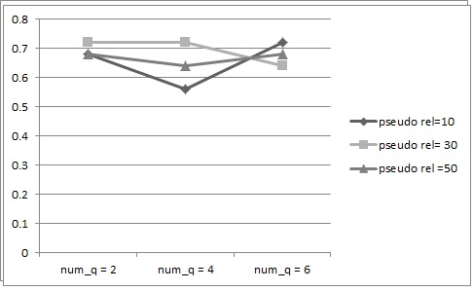
Result
The number of pseudo-relevant documents |R| are tuned at [10,30,50].The parameters γ,θ and α0 are tuned at 1,0.95 and 1.
Map and P@5 for systematically varied|˜Q|in terms of number of keywords [2,4,6]. N and T are kept constant at value 5 and 10 respectively
P@ 5 ->
03/05/2018
IR Project End Semester Evaluation

Slide 19
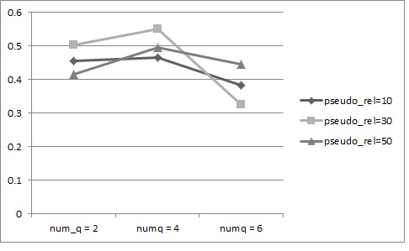
Result
Map @10 ->
03/05/2018
IR Project End Semester Evaluation

Slide 20
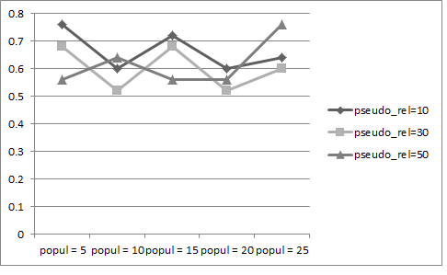
Result
P@5 and MAP@10 results for varying population length,N = [5,10,15,20,25]. |˜ Q| and T have values 4 and 10 respectively
P@5 - >
03/05/2018
IR Project End Semester Evaluation

Slide 21
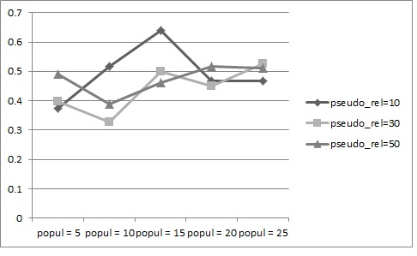
Result
MAP@10 - >
03/05/2018
IR Project End Semester Evaluation

Slide 22
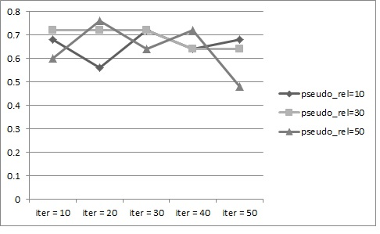
Result
P@5 and MAP@10 results for varying iterations T =[10,20,30,40,50] while |˜ Q| = 4 and N = 10
P@5 - >
03/05/2018
IR Project End Semester Evaluation

Slide 23
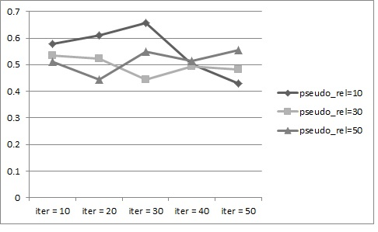
Result
MAP@5 - >
03/05/2018
IR Project End Semester Evaluation

Slide 24
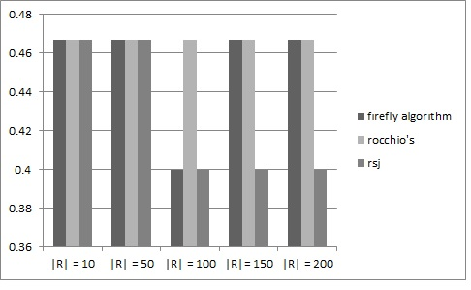
Result
Finally we compare the P@5 results of our ﬁreﬂy algorithm with that of Rocchio and RSJ algorithms.|˜ Q|=2,N=10,T=30. Thenumberofpseudo-relevantdocuments=[10,50,100,150,200].
P@5 - >
03/05/2018
IR Project End Semester Evaluation

Slide 25
Innovative Work Done
Developed a web interface which suggests the additional terms to be added to the query.
These additional terms computed by the ﬁreﬂy algorithm.
We have also reﬁned the original query by removing the terms with low inverse document frequency(IDF) factor in it and replacing them with the terms of the global best ﬁreﬂy
03/05/2018
IR Project End Semester Evaluation

Slide 26
Future Work
Improvise the ﬁreﬂy algorithm by designing a parallel variant of the same to increase both eﬃciency and eﬀectiveness of our IR system.
Further we will try to reﬁne the query using automatically generated thesaurus and synsets from WordNet.
03/05/2018
IR Project End Semester Evaluation

Slide 27
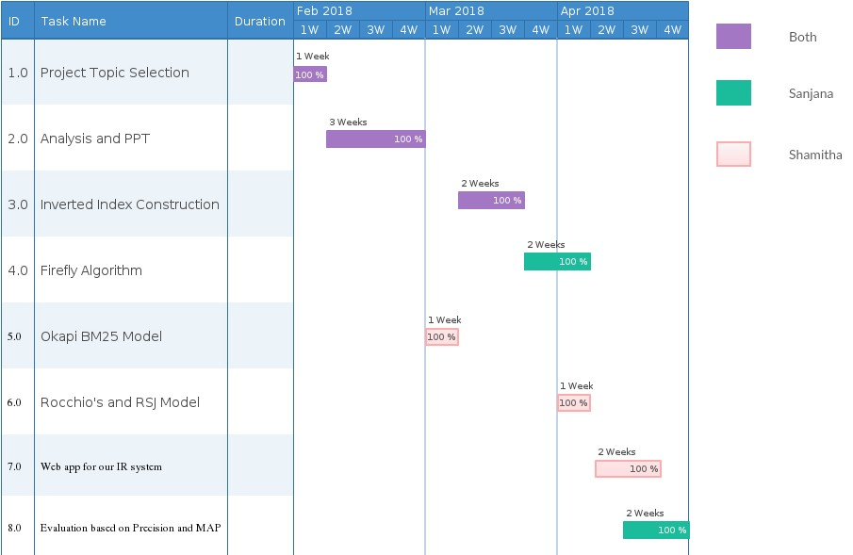
Time Line of Project
03/05/2018
IR Project End Semester Evaluation

Slide 28
References
Other References
Claudio Carpineto and Giovanni Romano
-A Survey of Automatic Query Expansion in Information Retrieval
Miao, J., Huang, J. X., and Ye, Z.,
-A deterministic resampling method using overlapping document clusters for pseudo-relevance feedback
Cao, G., J-Y. Nie, J. Gao, and S. Robertson
-Selecting good expansion terms for pseudo-relevance feedback
Lee, K. S., and Croft, W. B.,
-A deterministic resampling method using overlapping document clusters for pseudo-relevance feedback
Bindal, A. K., and Sanyal, S.
-Particle swarm optimization algorithm to improve pseudo relevance feedback
Robertson, S. E., Walker, S., Beaulieu, M., Gatford, M., Payne, A., -- -Okapi at trec-4
A Firefly Algorithm-based Approach for Pseudo-Relevance Feedback: Application to Medical Database
https://link.springer.com/article/10.1007%2Fs10916-016-0603-5
03/05/2018
IR Project End Semester Evaluation

